Slide 1
Binary

Slide 2

Binary
Binary describes a numbering scheme in which there are only two possible values for digit 0 and 1

Slide 3
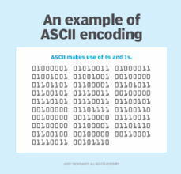
Computer using Binary
Computers can represent numbers using binary code in the form of digital 1s and 0s in the cpu

Slide 4
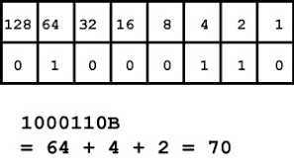
Binary equation
The equation

Slide 5
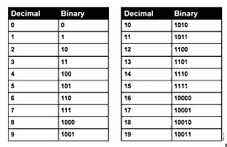
Binary table
The Binary table

Slide 6
Resources
1.https://en.wikipedia.org/wiki/Binary
2.https://www.google.com/imgres?q=binary&imgurl=https%3A%2F%2Fcdn.ttgtmedia.com%2Frms%2Fonlineimages%2Fns-encoding_decoding_ascii-h_half_column_mobile.png&imgrefurl=https%3A%2F%2Fwww.techtarget.com%2Fwhatis%2Fdefinition%2Fbinary&docid=mMPvGma5JvE2kM&tbnid=uObaWf4bu4wmKM&vet=12ahUKEwiqv5H-wqiHAxV0TEEAHTLMCAQQM3oECFkQAA..i&w=279&h=269&hcb=2&ved=2ahUKEwiqv5H-wqiHAxV0TEEAHTLMCAQQM3oECFkQAA
3.https://www.google.com/imgres?q=binary&imgurl=https%3A%2F%2Fi0.wp.com%2Fblog.doublehelix.csiro.au%2Fwp-content%2Fuploads%2F2014%2F01%2Fbinary1.jpg%3Fssl%3D1&imgrefurl=https%3A%2F%2Fblog.doublehelix.csiro.au%2Fbinary-for-beginners%2F&docid=EnYAk0C-L7d87M&tbnid=rUEixZJABzMb9M&vet=12ahUKEwiqv5H-wqiHAxV0TEEAHTLMCAQQM3oECFcQAA..i&w=300&h=172&hcb=2&ved=2ahUKEwiqv5H-wqiHAxV0TEEAHTLMCAQQM3oECFcQAA
4.https://www.google.com/imgres?q=binary&imgurl=https%3A%2F%2Farejei.com%2Fcdn%2Fshop%2Ffiles%2Fcounting-in-binary_1600x.jpg%3Fv%3D1636871725&imgrefurl=https%3A%2F%2Farejei.com%2Fpages%2Fwhat-is-binary&docid=UfHXf84UIMxpVM&tbnid=8pGY3wjjnGv_xM&vet=12ahUKEwiqv5H-wqiHAxV0TEEAHTLMCAQQM3oECBwQAA..i&w=650&h=422&hcb=2&ved=2ahUKEwiqv5H-wqiHAxV0TEEAHTLMCAQQM3oECBwQAA
5.https://www.google.com/imgres?q=binary&imgurl=https%3A%2F%2Fmathematicalmysteries.org%2Fwp-content%2Fuploads%2F2022%2F08%2Fbinary-number-system.png%3Fw%3D1400&imgrefurl=https%3A%2F%2Fmathematicalmysteries.org%2Fbinary-number-system%2F&docid=j8KVgaK5C2WynM&tbnid=S3h5gox1DYuyBM&vet=12ahUKEwiqv5H-wqiHAxV0TEEAHTLMCAQQM3oECGcQAA..i&w=1400&h=787&hcb=2&ved=2ahUKEwiqv5H-wqiHAxV0TEEAHTLMCAQQM3oECGcQAA

